Slide 1
OCEAN STATION PROJECT
CESAR JUNG-HARADA X EMERGING ISLANDS

Slide 2
ANJODC TREATMENT

Slide 3
STRUCTION AND FLOW
INTRO : LA UNION TEXTURE
VISION OF THE INTERNATIONAL OCEAN STATION
ACTIVITIES / WORKSHOP
PROCESS OF BUILDING THE STATION
CALL TO ACTION
END

Slide 4
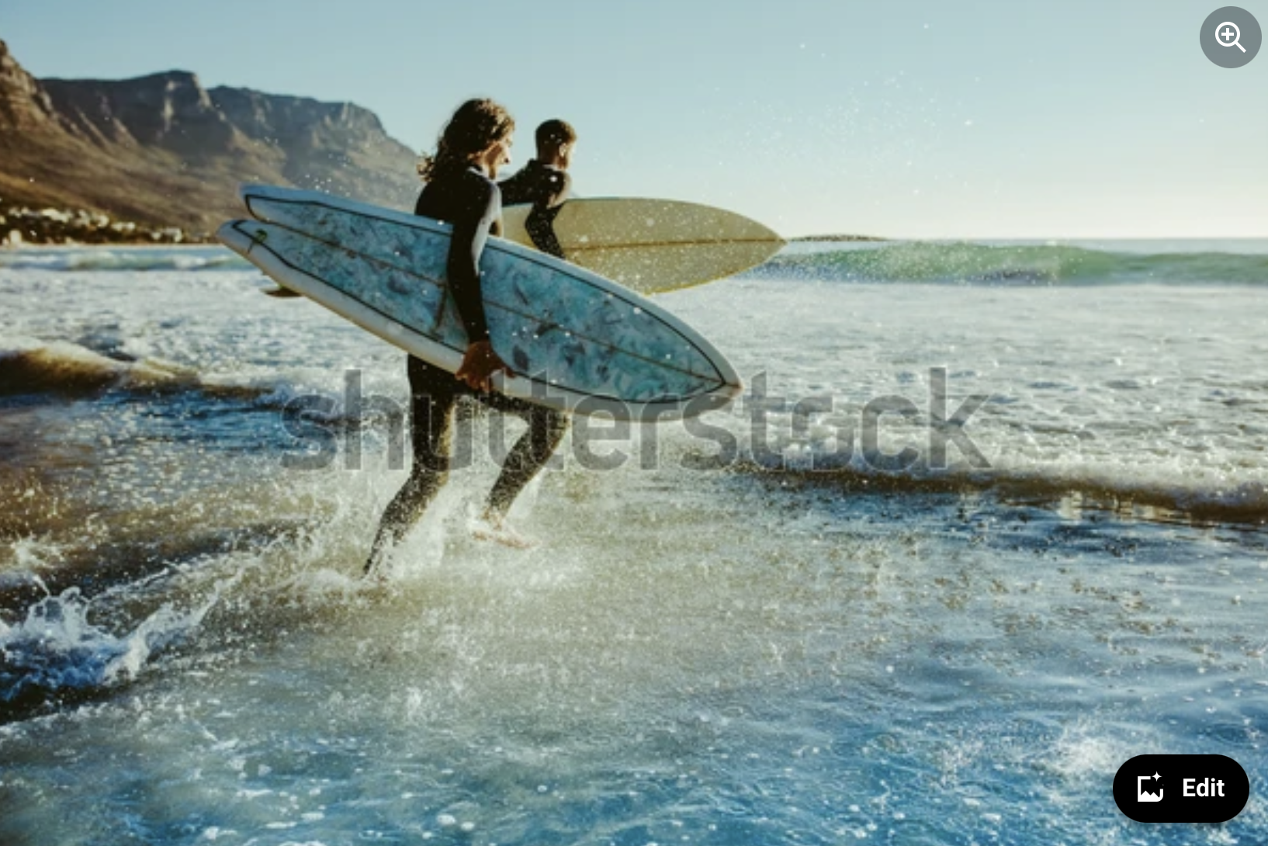
INTRO : LU TEXTURE
INTENT
to establish La Union with its cultural elements (beach, surf, community)
to establish la union as an ideal place for Ocean Station Project
SUBJECTS
La Union, beach, community, activities like surfing

Slide 5
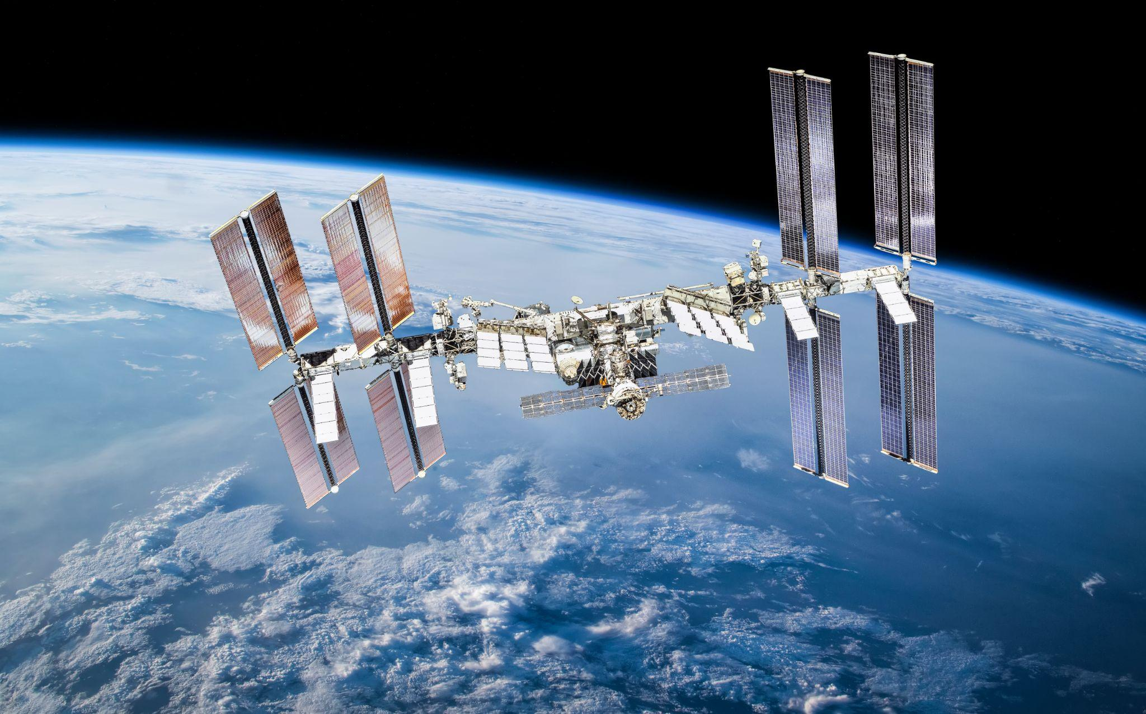
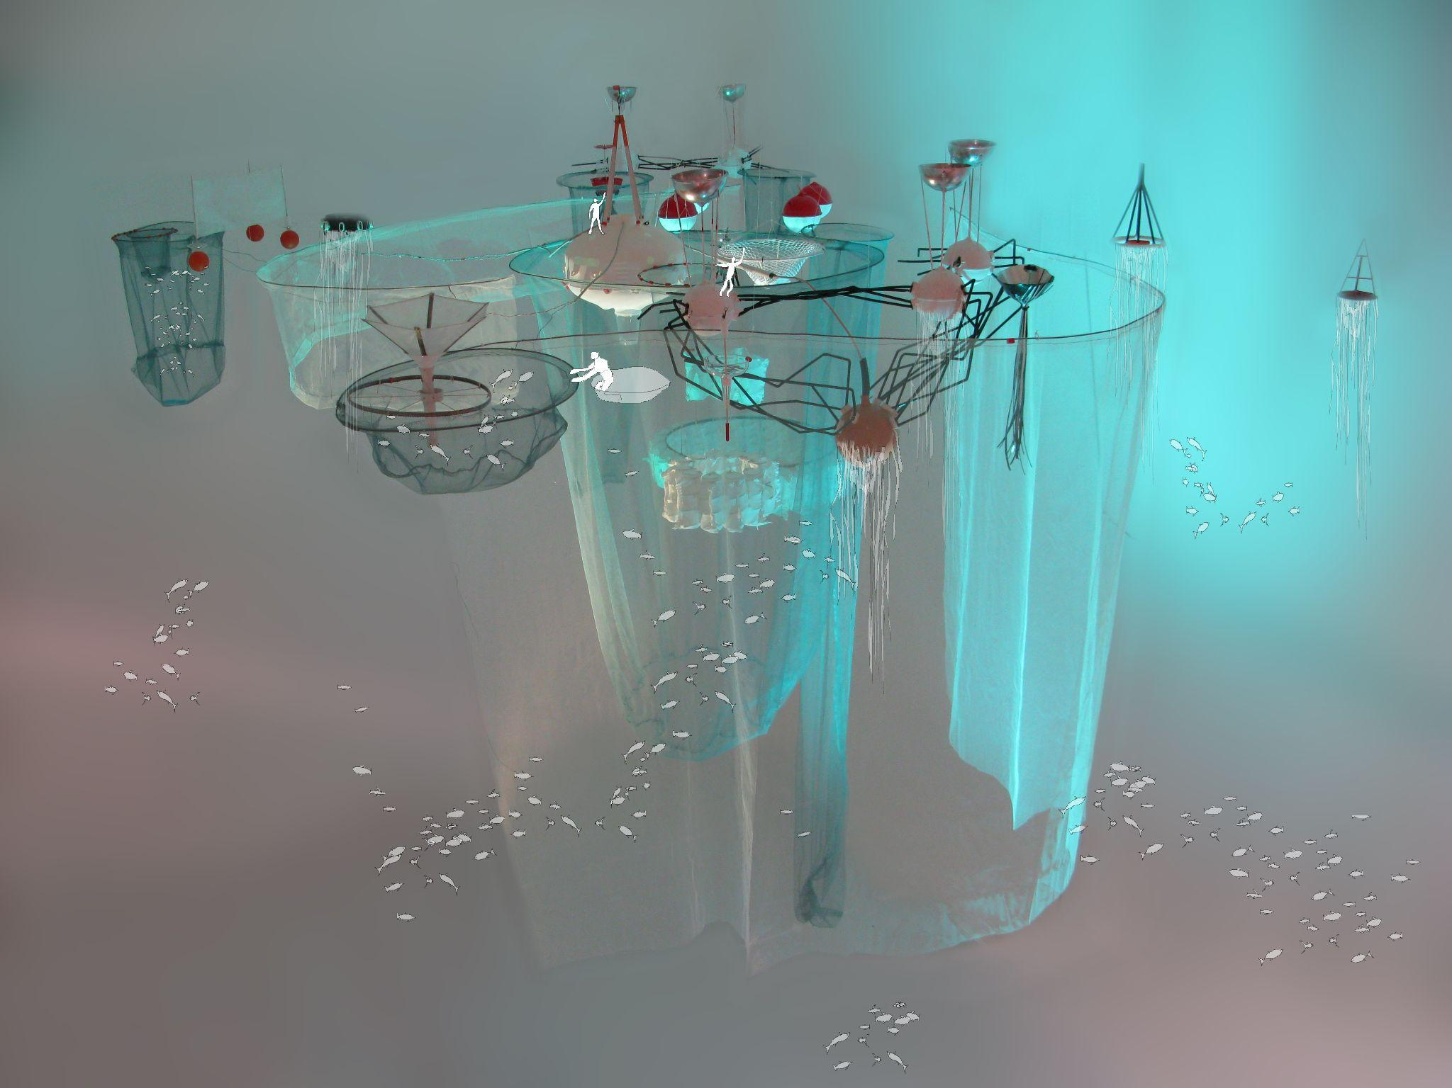
VISION: INTERNATIONAL OCEAN STATION
INTENT
to establish La Union with its cultural elements (beach, surf, community)
to establish la union as an ideal place for Ocean Station Project
SUBJECTS
La Union, beach, community, activities like surfing

Slide 6
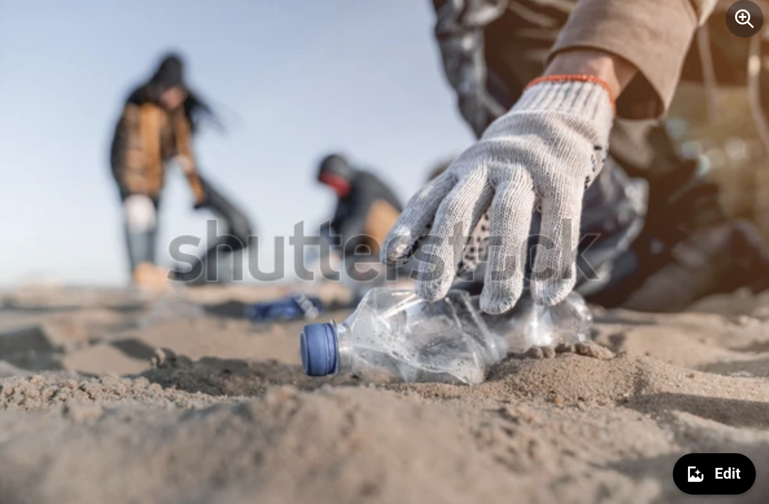
ACTIVITIES / WORKSHOP
INTENT
to highlight the important activities that will be done thru out the week / workshop
Planning, brainstorming, various parts of the building days
SUBJECTS
scheduled activities, work day, clean up
people participating the events

Slide 7
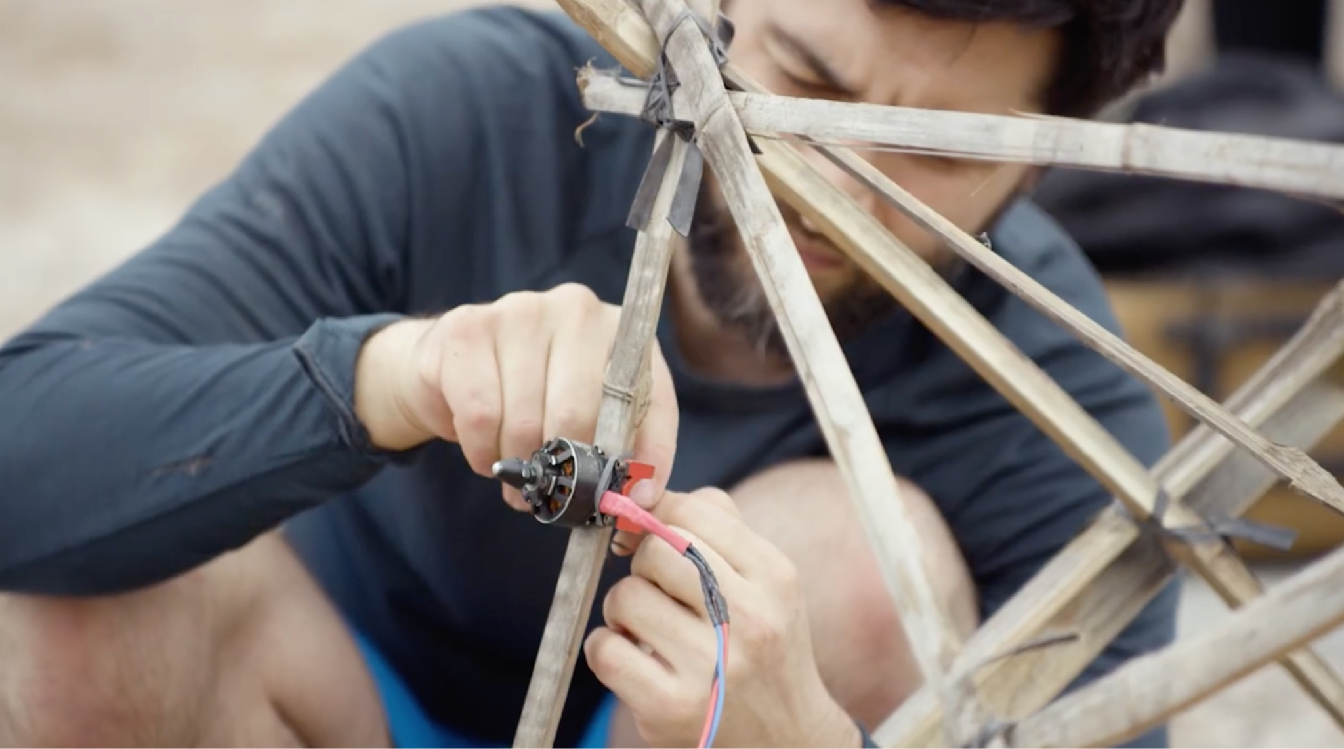
PROCESS OF BUILDING THE STATION
INTENT
to establish the process ; collaboration w Cesar.
Cesar / participants talk about the process of each activity / event.
To establish the people that are involved in the project
SUBJECTS
People working together, materials,

Slide 8
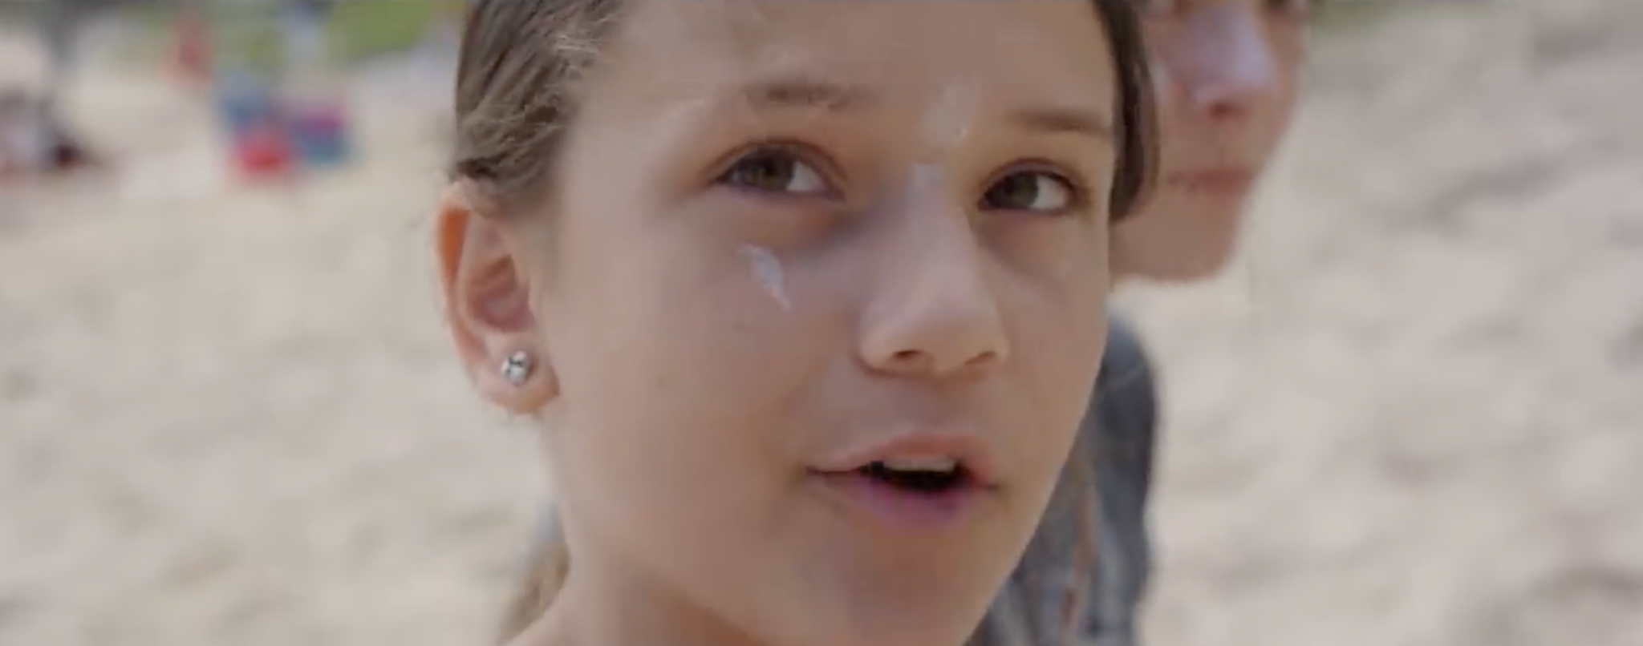
CALL TO ACTION / LAUNCH
INTENT
Cesar / participants talk about the importance of this activities for us to take care of our place / Ocean (something he can talk about on a sunset).
***Character from Curma / participants talks about the importance of this project for Curma and other local orgs.
How this project will benefit the community and LU in the long run.
SUBJECTS
Cesar final message, launch day, celebration with the community

Slide 9
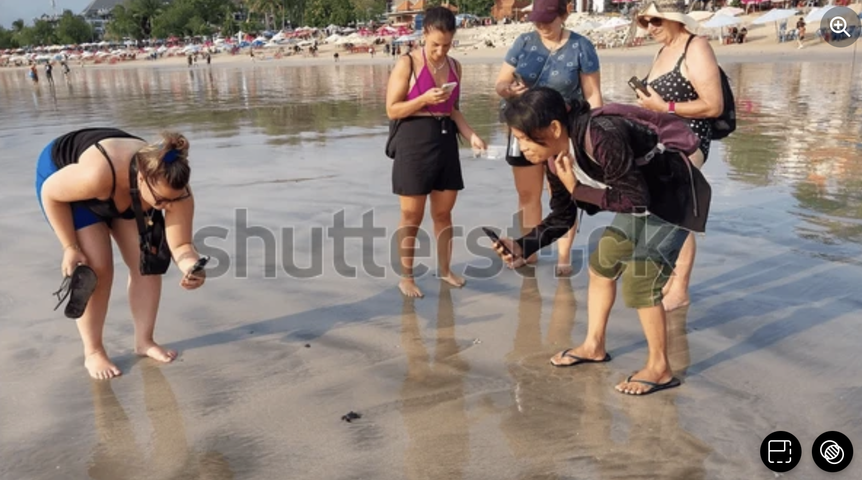
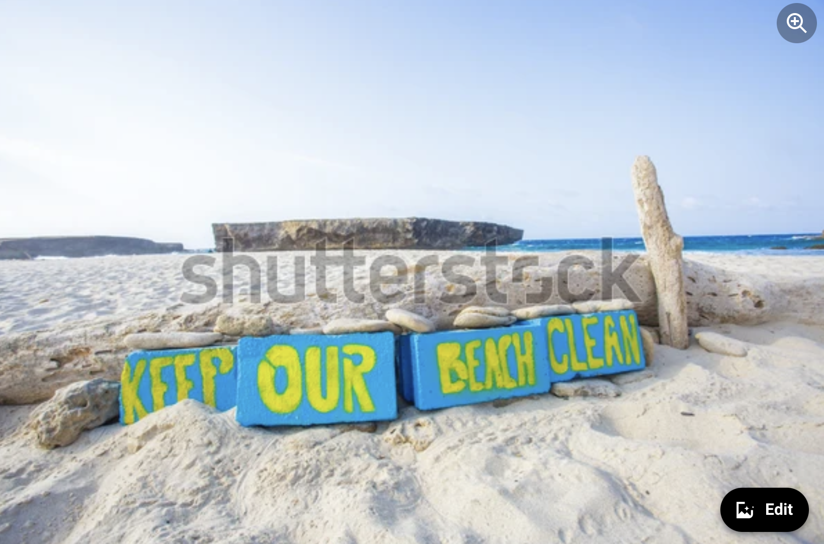
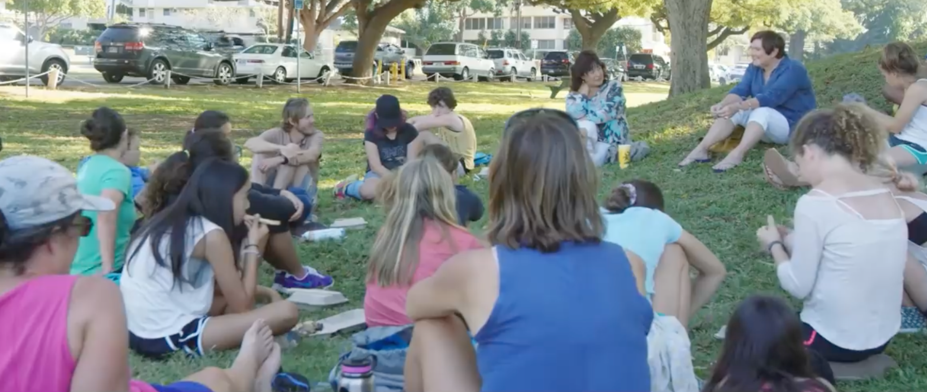
END
INTENT
To highlight all the activities to provide an uplifting and inspiring feel towards the end of the video
SUBJECTS
Montage of all activities that were shot
People working together

Slide 10
SHOTS TREATMENT
DOCU - STYLE
MOSTLY HANDHELD
SEMI ON THE SPOT / AMBUSH INTERVIEWS DURING EVENTS
60FPS FOR SLO-MO OPTION FOR ACTIVITIES ETC.

Slide 11
LOOK AND FEEL

Slide 12
SIMILAR WORK IN LU

